Slide 1

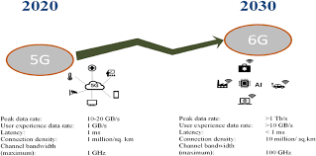
SHOPTALK OF THE MONTH
The Evolution of Wireless Communication: From 5G to 6G
APRIL
2026
Name:-AYUSH PRASAD
Course:- COMPUTER SCIENCE
Section:- C1
Centre:- RD TATA TECHNICAL EDUCATION CENTRE,NTTF
Notes:
Good afternoon everyone. My name is Ayush Prasad, and today I'll be presenting on one of the most exciting frontiers in technology — the evolution of wireless communication from 5G to the upcoming 6G. This is a topic that will shape everything from how we browse the internet to how surgeons perform operations from across the world.

Slide 2
Introduction
Wireless communication has evolved rapidly from basic voice calls to ultra-fast internet and smart connectivity.
While 5G is still being deployed worldwide, researchers are already working on 6G technology.
6G aims to enable futuristic applications such as holographic communication, remote surgery, and fully immersive virtual environments.
This presentation explores how we are moving from 5G to the next generation of wireless technology.
Notes:
Wireless communication has come a long way. From the days of simple voice calls, we now have networks that connect billions of devices at lightning speed. Even as 5G is still being rolled out globally, researchers are already designing its successor — 6G. 6G is expected to support applications we can barely imagine today: real-time holograms, remote robotic surgery, and fully immersive digital environments. This presentation will walk you through how we got here and where we're headed.

Slide 3
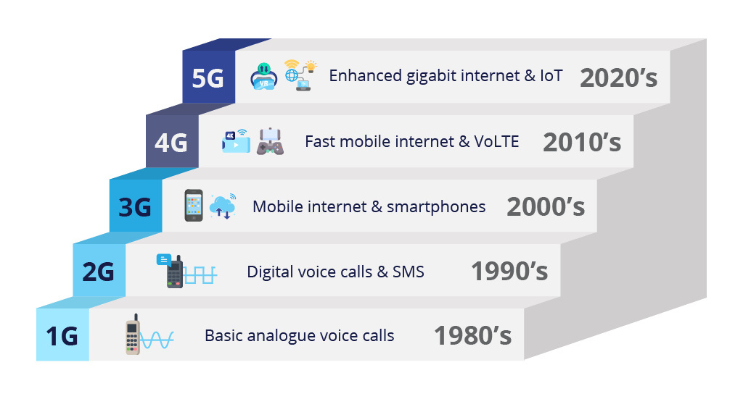
Evolution (1G to 6G)
Notes:
Each generation of wireless technology brought a fundamental shift in what was possible. This isn't just about speed — each G represents a new era of human communication and interaction. We'll look at this journey briefly before diving deeper.

Slide 4
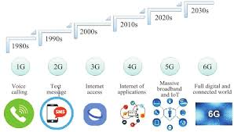
1G to 4G
1G: Analog voice communication
2G: Digital voice + SMS
3G: Mobile internet & multimedia
4G: High-speed internet, streaming, and apps
➤ Overall shift: From basic voice calls to high-speed mobile internet
5G (Present)
Ultra-high speed up to 20 Gbps
Extremely low latency (~1 ms)
Supports technologies like IoT, smart cities, and autonomous vehicles
6G (Future – 2030+)
Expected speeds up to 100x faster than 5G
Concept of “Internet of Everything” (everything connected intelligently)
Will enable advanced applications like AI-driven networks, holograms, and real-time remote operations
Notes:
1G gave us analog voice. 2G brought digital voice and SMS. 3G opened the door to the mobile internet. 4G made streaming, apps, and always-on connectivity mainstream. 5G, which is being deployed right now, pushes speeds up to 20 Gbps with near-zero latency. And 6G, expected around 2030, aims to be 100 times faster than 5G — creating what researchers call the 'Internet of Everything.

Slide 5
5G – The Current Foundation
Core Technologies:
Massive MIMO (Multiple Input Multiple Output):
Uses a large number of antennas at base stations to send and receive multiple data signals simultaneously→ improves speed, capacity, and efficiency.
Millimeter Wave (mmWave):
Uses very high-frequency bands (30–300 GHz) → enables ultra-fast data speeds, but has short range and limited penetration (e.g., walls).
Network Slicing:
Divides a single network into multiple virtual networks → each optimized for specific uses (e.g., gaming, healthcare, IoT) → ensures better performance and reliability.
Notes:
5G is powered by three key technologies. First, Massive MIMO — using large arrays of antennas to serve many users simultaneously, dramatically improving capacity. Second, millimeter wave spectrum — very high-frequency bands that deliver incredible speeds, though they struggle to penetrate walls and have limited range. Third, network slicing — which allows a single physical network to be divided into multiple virtual networks, each tuned for a specific application like healthcare, gaming, or industrial IoT.

Slide 6
Impact of 5G:
Growth of IoT (Internet of Things):
Connects billions of smart devices (smart homes, wearables, industrial sensors)
Enables real-time data communication
Stable AR/VR Streaming:
Low latency (~1 ms) allows smooth and immersive experiences
Supports applications like virtual gaming, training simulations, and remote collaboration
Notes:
The real-world impact of 5G is already visible. It connects billions of smart devices — from wearables and smart home systems to industrial sensors on factory floors. The ~1 millisecond latency is a game changer for AR and VR, making experiences smooth and immersive enough for professional use cases like surgical training, military simulations, and remote collaboration.

Slide 7
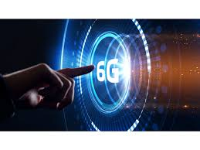
Why Do We Need 6G?
1. Data Explosion:
Rapid growth of connected devices
5G may reach capacity limits
Need for faster, real-time communication
New Requirements:
Supports XR, holograms, remote surgery
Requires ultra-high speed & low latency
3. Sustainability:
Reduces energy consumption
More efficient and eco-friendly networks
Notes:
So if 5G is this powerful, why are we already talking about 6G? Three main reasons. First, data explosion — the number of connected devices is growing exponentially and 5G will eventually hit its capacity ceiling. Second, new requirements — applications like extended reality, holographic calls, and remote surgery demand speeds and latency that even 5G cannot guarantee consistently. Third, sustainability — 6G is being designed from the ground up to be energy efficient, which is critical as global data consumption skyrockets.

Slide 8
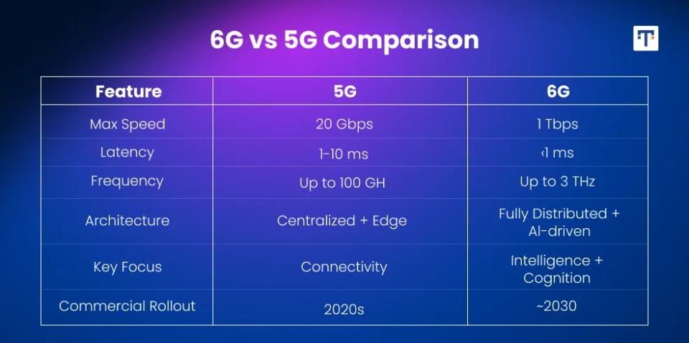
6G vs. 5G – The Performance Leap
Comparision Table:
Notes:
This table summarizes the performance leap from 5G to 6G. Notice the jump in peak data rate, latency, and connection density. These aren't just incremental improvements — they represent entirely new capabilities that will unlock applications that are simply not viable on today's networks.

Slide 9
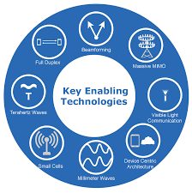
Key Enabling Technologies for 6G
1. Terahertz (THz) Waves:
Ultra-high frequency (95 GHz–3 THz)
Speeds up to 1 Tbps
Best for XR & holograms
Challenge: short range
2. AI-Native Architecture:
AI built into core network
Self-optimizing & low latency
Smarter traffic management
3. Reconfigurable Intelligent Surfaces (RIS):
Reflect & boost signals
Fix coverage gaps
Improve efficiency
Notes:
Three technologies will define 6G. Terahertz waves operate between 95 GHz and 3 THz — delivering speeds up to 1 terabit per second, ideal for holograms and XR, though the short range is a challenge being actively researched. AI-native architecture means artificial intelligence won't just be a tool on top of the network — it will be baked into the network itself, enabling self-optimization and real-time decision making. Finally, Reconfigurable Intelligent Surfaces — smart panels that reflect and redirect signals to eliminate dead zones and improve coverage, especially in dense urban environments.

Slide 10
Challenges & Roadblocks
High Cost: Expensive deployment of dense small-cell networks
Signal Issues: THz waves easily blocked (walls, rain, etc.)
Security Risks: More data + AI → higher cyber threats (need Zero-Trust)
Notes:
6G won't arrive without obstacles. The infrastructure cost is enormous — dense small-cell networks are expensive to build and maintain. THz signals are easily absorbed by walls, humidity, and even rain, which limits range. And as AI becomes embedded in networks, the security surface area expands significantly — new zero-trust security frameworks will be essential to protect against increasingly sophisticated cyber threats.

Slide 11
Conclusion & 2030 Vision
6G is not just an upgrade but a transformation of connectivity.
It will create an intelligent, sensor-driven digital world.
Countries are already competing to lead in 6G development.
The next decade will define global technological leadership.
Notes:
To close — 6G is not simply a faster version of 5G. It represents a complete reimagining of connectivity: intelligent, sensor-driven, and deeply integrated into every aspect of our digital lives. Nations like China, South Korea, the US, and the EU are already investing heavily to lead in 6G development. The decisions made in the next decade will determine who leads the global technology landscape in 2030 and beyond. Thank you.

Slide 12
THANKYOU

